Slide 1
C2P India
QA Track
Approval Service and 4 Eye Verification

Slide 2
Agenda
Question and Answers
Approval Service
4 Eye Verification

Slide 3
Agenda
Question and Answers
Approval Service
4 Eye Verification

Slide 4
Approval Service
Approval
Refers to the functionality which is offered to a user to approve a payment prior to processing it further
Approval can be invoked from the Interchange/Instruction/Transaction flow:
The Issue Processor can be configured to trigger approval, after which the approval type for the issue at hand is invoked
Underlying entities are not processed further until the upper entity has been approved

Slide 5
Approval Service
The Service creates a WLI to inform the Bank User that an approval action is expected on the payment.
The Bank user can provide either one of the following actions through the appropriate instruction/transaction action details tab
Approve – Indicates the payment can continue processing
Decline – rejects the payment
Send to Repair – invokes Manual Repair for the payment since some changes may have to be applied on the payment.

Slide 6
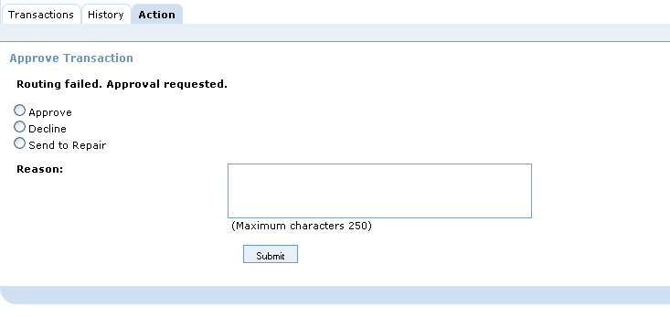
Approval Service
Once the payment is approved by the user,
either 4 Eye Verification shall be invoked or
instruction / transaction continues further processing
based on the bank’s requirements.

Slide 7
Approval Service - Steps
The basic steps carried out by Approval Service:
1
An issue is raised by a certain service (e.g. Disposition check on account status failed – account blocked).
2
The Issue Processor determines the outcome as “Approval”.
3
The approval service is invoked with a certain approval type, related to the issue which occurred.
4
A history record and Work List Item is created, and the Payment waits until it is approved
5
User can take action from the WLI screen or Actions tab on the payment entity.
6
Before continuing processing or retry executing the previous service, the payment might require 4-eye verification
7
The payment continues processing after the payment has been 4-eye verified.
8
The Work List Item is completed

Slide 8
Agenda
Question and Answers
Approval Service
4 Eye Verification

Slide 9
4 Eye Verification
The purpose of 4-Eye Verification (4EV) is to allow a second bank user to either approve or decline the action taken on a payment by a first (other) user.
When a payment goes through Approval or Repair, and the BVA user performs an action, the 4-Eye Verification Service is invoked.
The calling service (for ex: Approval Service) will check whether 4-eye verification is required. If so, it will create a WLI to inform the Bank User that a 4EV action is expected on the payment.

Slide 10
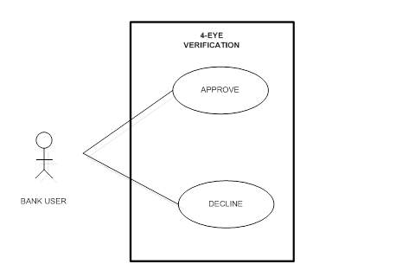
4 Eye Verification - Actions
The Bank user can provide either one of the following actions through the appropriate interchange/instruction/transaction action details tab or from WLI screen.
4-Eye Verification screen does not allow a bank user to change any information of the interchange/instruction/transaction.

Slide 11
4 EV – Actions and Outcomes
Approve the action taken on payment interchange/instruction/transaction
The status of the WLI is updated to “Completed”.
The status of interchange/instruction/transaction is set to “Processed” and the payment process continues.
Decline the action taken on payment interchange/instruction/transaction
The status of the WLI is updated to “Completed”.
The status of the interchange/instruction/transaction is set same as it was pre-4EV for ex: “Awaiting Approval” or “Awaiting Repair” and a new issue is generated.

Slide 12
4 Eye Verification - Steps
The basic steps carried out by 4EV Service:
1
If 4-Eye Verification is needed, a new work list item is created
2
If user approves the changes, the payment process resumes and the status of the WLI will be updated to “Completed”,
else the payment process continues.
else payment goes back to same state in the flow as it was pre-4EV and the status of the previous WLI is set to “Completed”.

Slide 13
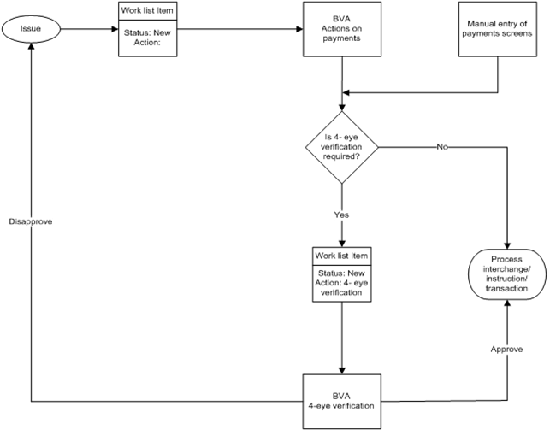
Workflow for 4-Eye Verification

Slide 14
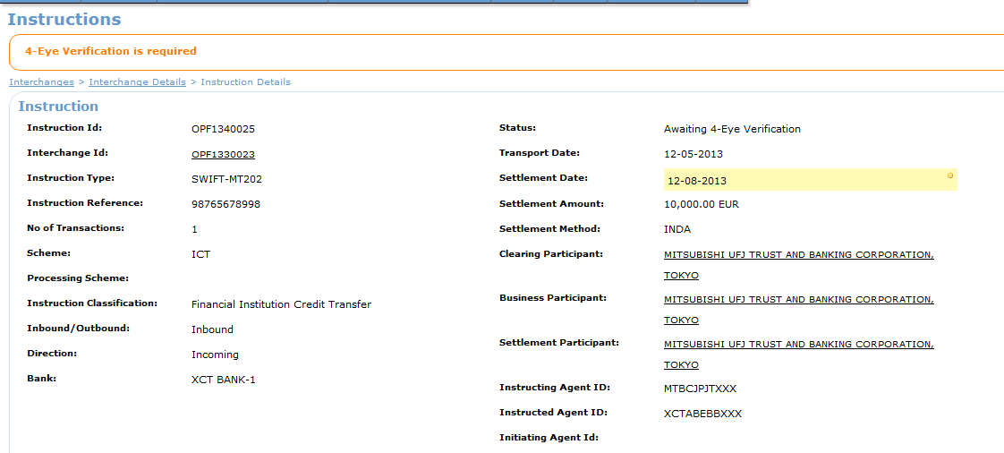
4 Eye Verification from Action Tab (1)
4-eye verification can be done for an action taken on an Interchange, Instruction or Transaction
Instruction status is
“Awaiting 4 Eye Verification”

Slide 15
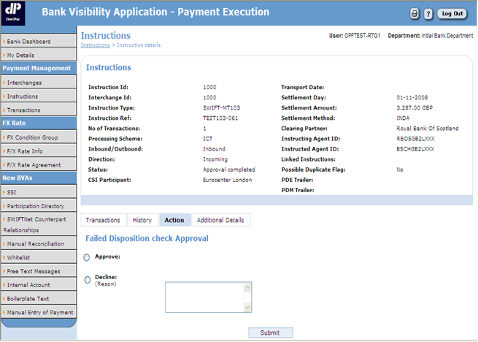
4 Eye Verification from Action Tab (2)
Actions Tab

Slide 16
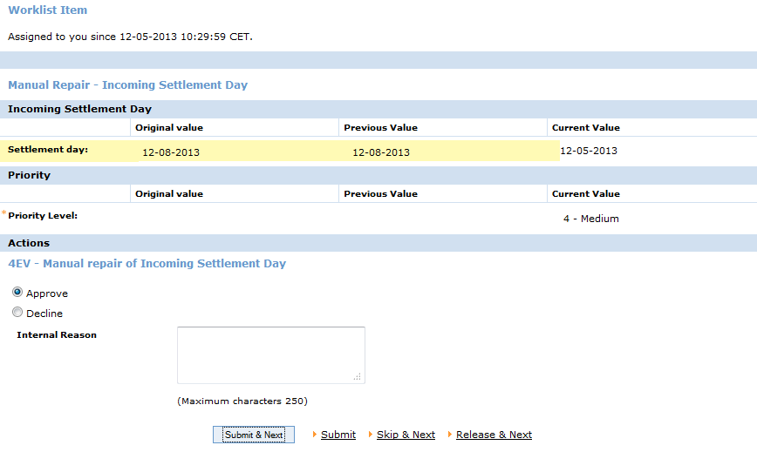
4 Eye Verification from WLI screen
4-eye verification can be done from WLI screen, after claiming the WLI.
From WLI screen

Slide 17
Options at WLI Screen
Releases the WLI,
status of WLI changes to ‘New’
and next WLI is displayed
Submit the user action and
displays payment entity screen
No action is taken and
displays next WLI
Submit the user action
and displays next WLI

Slide 18
WLI Service Workflow

Slide 19
4 Eye Verification – Configured Features
The list of actions where 4-Eye Verification is required is configurable.
Example features that are configured for 4-eye verification includes:
Flow | Steps in the flow where 4-Eye Verification is invoked
Incoming interchange Validation | Duplicate Check Approval
CT Instruction flow | Manual Entry
“On us” CT Transaction flow | Credit Party Account Blocked Approval

Slide 20

Question & Answers
Open your mind and let the thoughts flow around

Slide 21
EMEA – Headquarters
Brussels, Belgium
info@clear2pay.com
APAC
Sydney, Australia
info.apac@clear2pay.com
Americas
Atlanta, USA
info.americas@clear2pay.com
www.clear2pay.com

